Slide 1


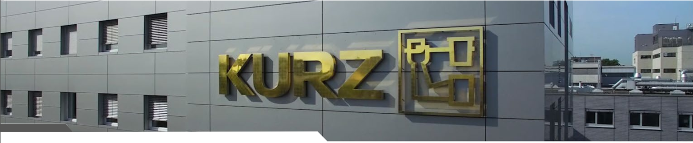
Plastic Decoration
Hot Stamping – IMD – INS Technology

Slide 2

Plastic Decoration
AGENDA
I. Some application
II. Kurz product
III. Kurz Technologies

Slide 3













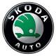










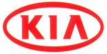
I. Some application
Advanced Automotive Plastic Decoration

Slide 4

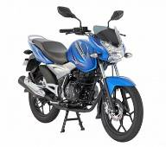
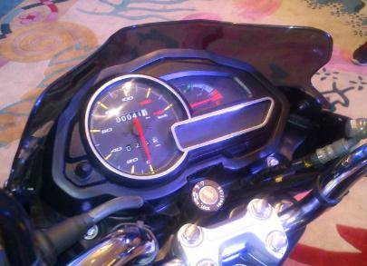
I. Some application
Automotive Plastic Decoration
India
Discover
HS
Notes:
4

Slide 5
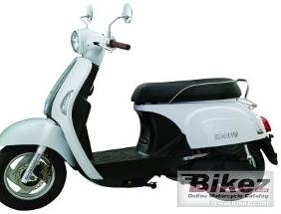
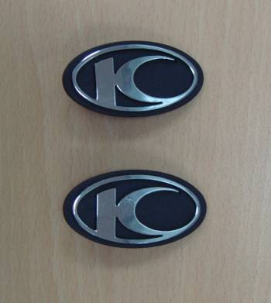
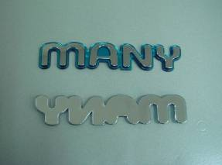
I. Some application
Automotive Plastic Decoration
Taiwan
HS
2nd surface decoration
first surface decoration

Slide 6
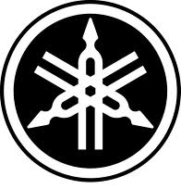
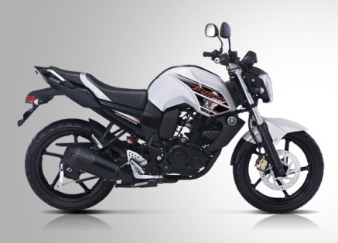
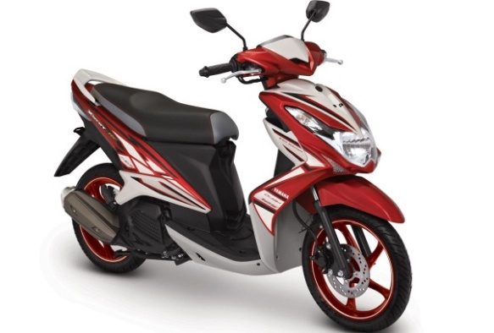
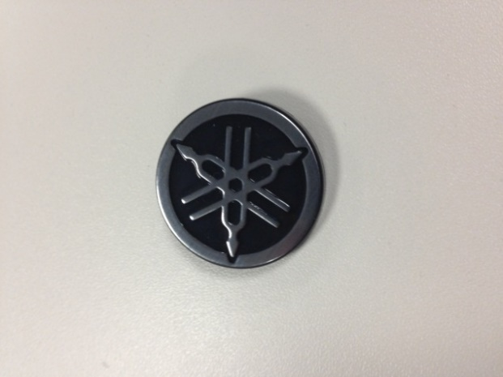
I. Some application
Automotive Plastic Decoration
Japan
Yamaha 2-wheelers
HS
Part Production in:
Indonesia
Models: Mio J, Mio Sporty, Xeon, Jupiter MX, Jupiter Z and Byson
Notes:
6

Slide 7

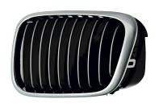



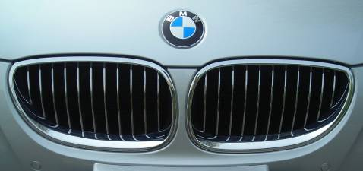

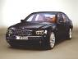
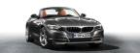
I. Some application
Automotive Plastic Decoration
Europe
HS
Part Production in:
Germany + Spain

Slide 8

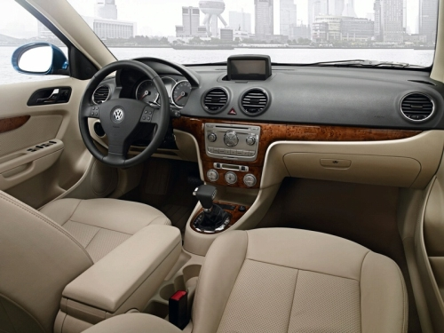
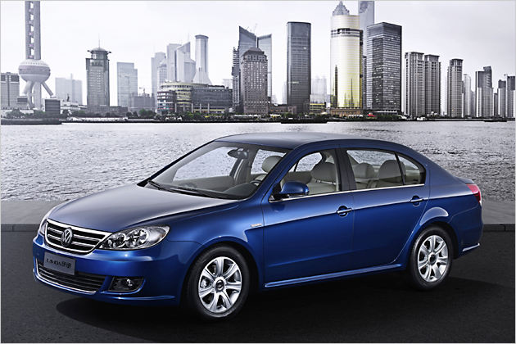
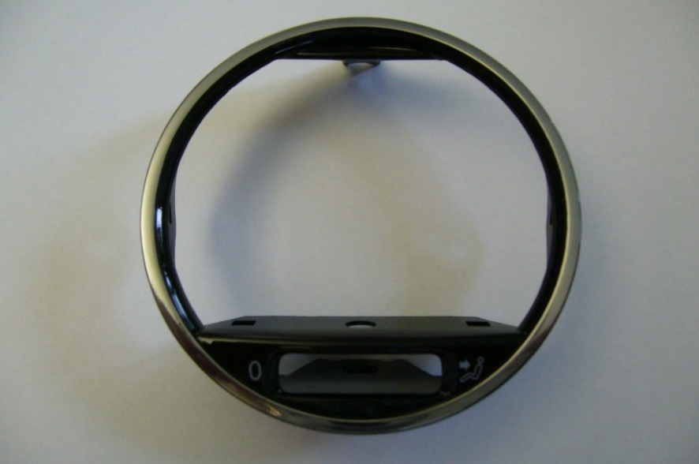
I. Some application
Automotive Plastic Decoration
Europe
HS
SVW Lavida
CHROME GLC 73725-05

Slide 9
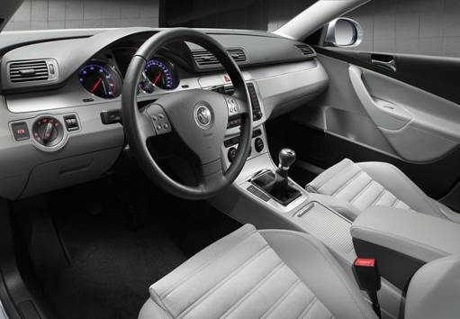


I. Some application
Automotive Plastic Decoration
China
IMD
Magotan
HS
Tubenringe
Part Production in:
China

Slide 10

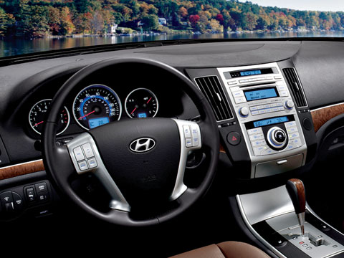
I. Some application
Automotive Plastic Decoration
Korea
Veracruz
INS
Part Production in:
Korea

Slide 11
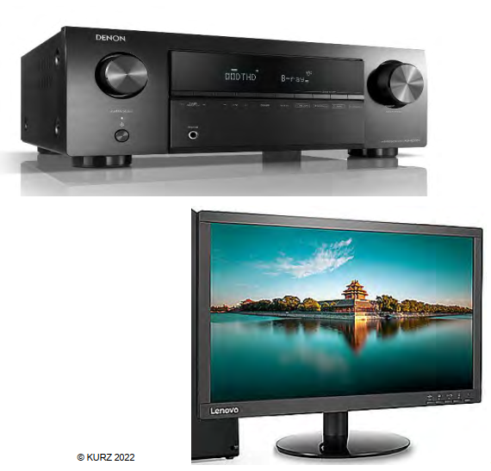
I. Some application
Home Plastic Decoration
HS

Slide 12
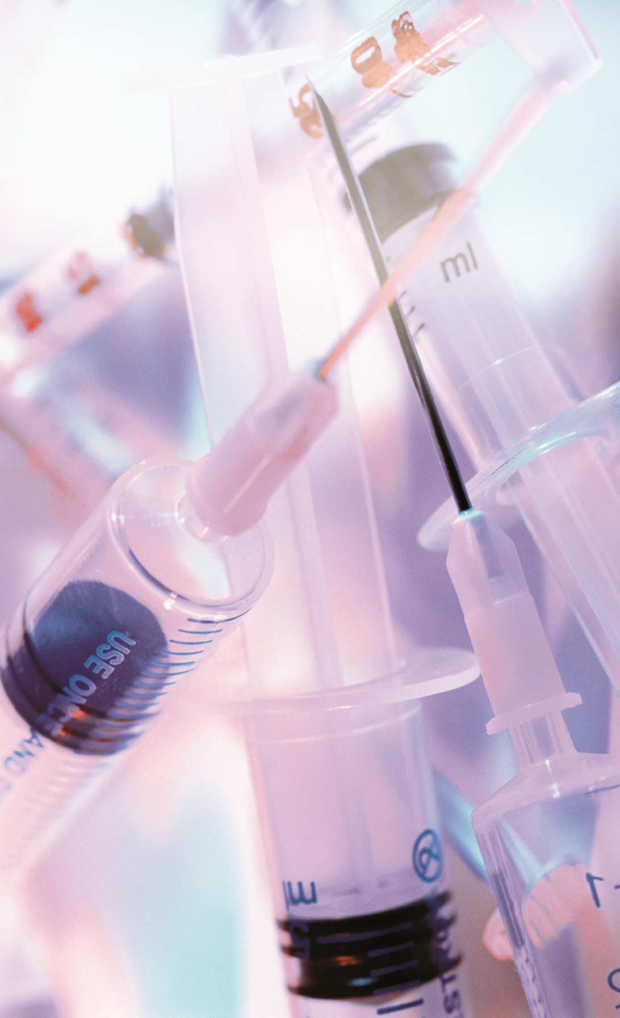
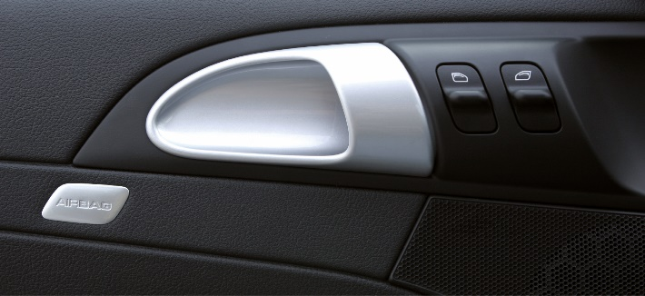
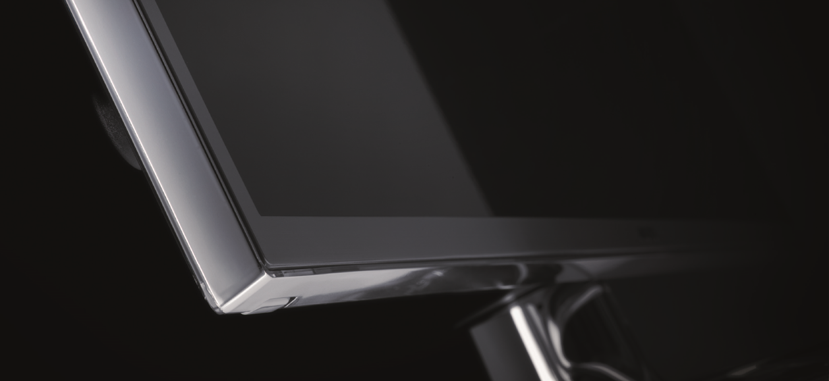
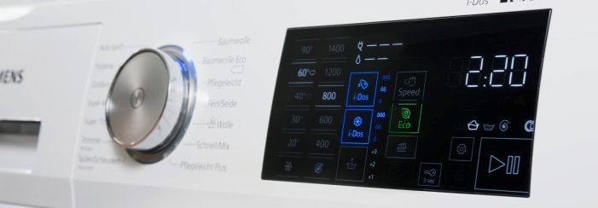
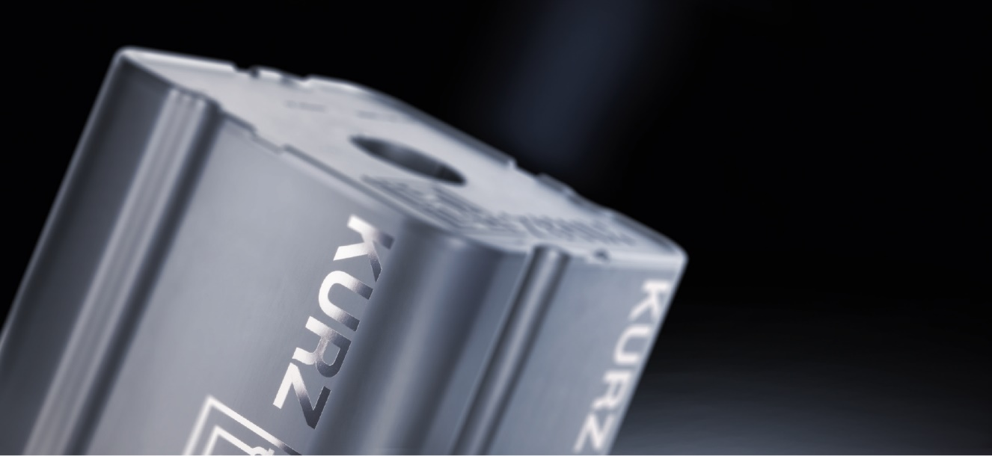
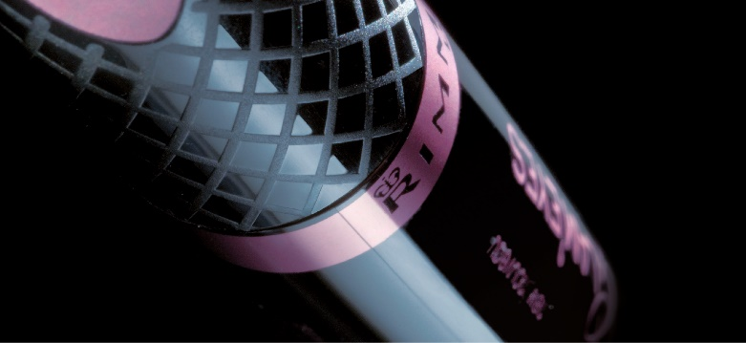
I. Some application
Other Plastic Applications
automotive
medical
consumer
electronics
home
applicances
industrial
cosmetics

Slide 13

II. Kurz product
One stop shop
Development partner and solution provider
From the first idea to the final product
Foil development
Project engineering
Tool
Foil – CMF Design
Foil feeding device
Hot stamping machine
Process optimization
Global project management
Design definitation
00000

Slide 14
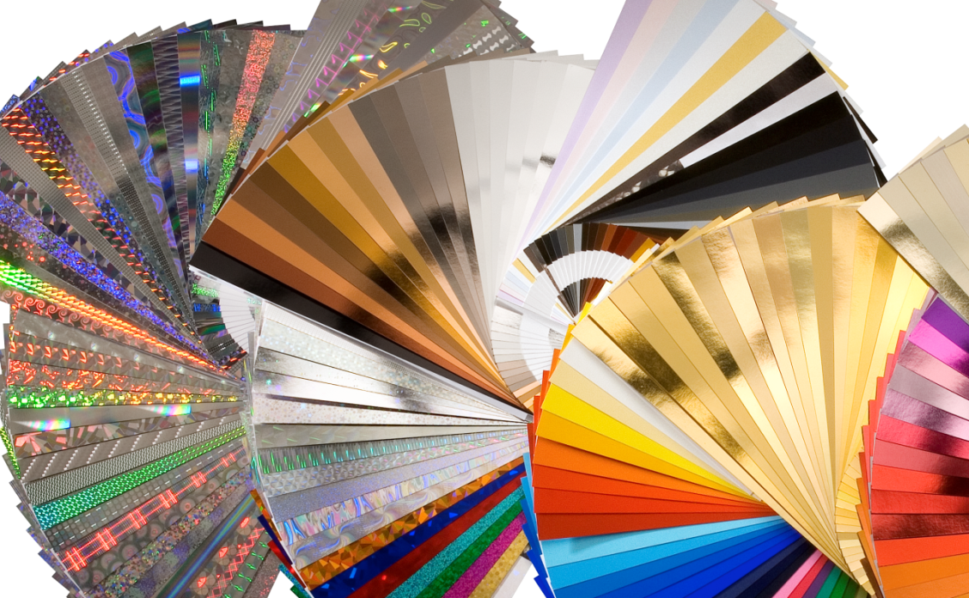
II. Kurz product
Wide range of Decoration design

Slide 15
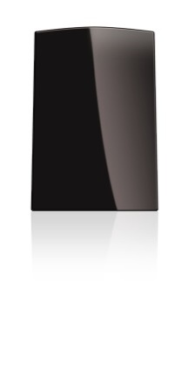
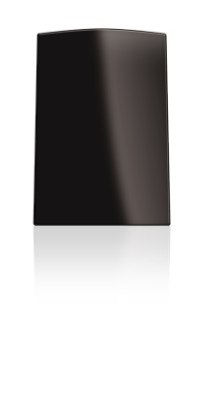
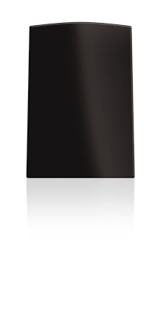
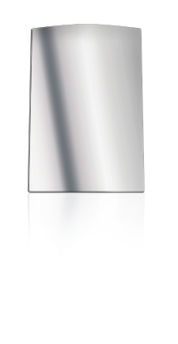
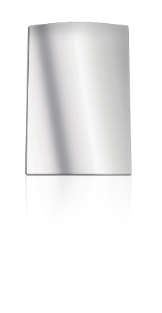
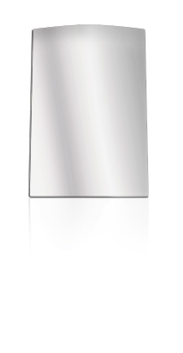
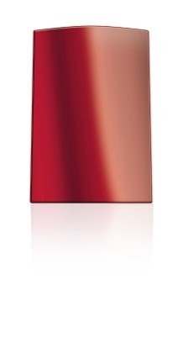
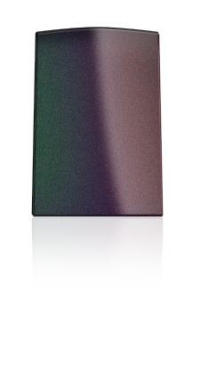
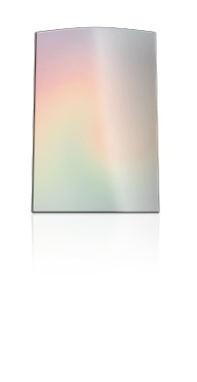
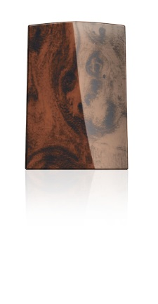
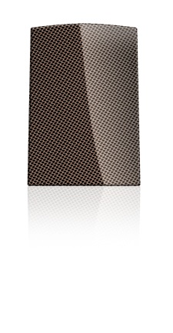
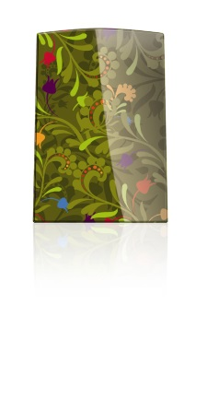
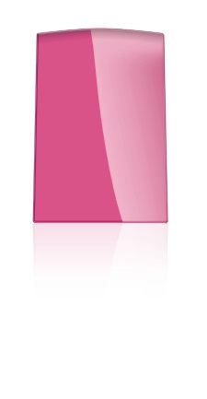
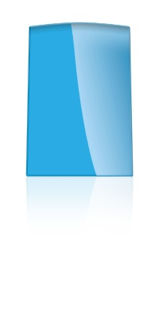
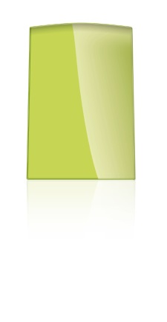
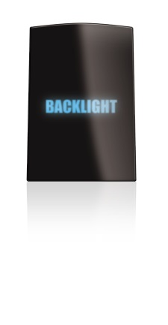
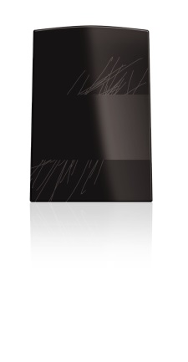
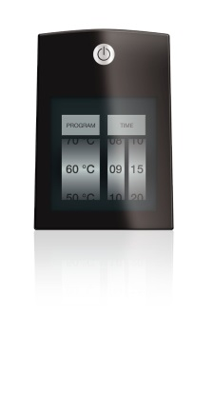
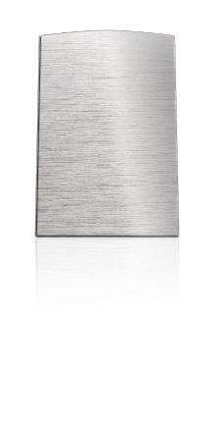
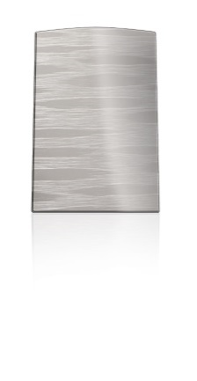
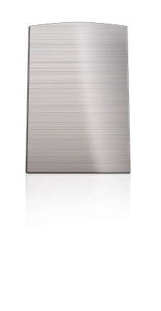




II. Kurz product
Request by customer
Gloss level
From high gloss through matte to supermatte
Metals
Select from – chrome, aluminium, ncvm
Effects
Metalized colors, flip effects, sandblast / anodized
Patterns
Decoration without limits
Colors
Company colors, trend colors and classics
Functions
Backlight, protective coating, capacitive touchscreens
Brushed textures
Printed or real brushed,
long or short scraperboard
Specials
Second surface, transparency, haptics

Slide 16




II. Kurz product
Machines & Tools

Slide 17

III. Kurz Technologies
INS: INSERT MOLDING
IMD: IN - MOLD - DECORATION
HS: HOT STAMPING
More details will be present in an upcoming presentation

Slide 18


